Slide 1
YZV 211 Project
Society and Depression Analysis with Data
Team: D&S
Team Members:
Hakan Erdem - 150200313
Doruk Üzgün - 150200311

Slide 2


Hakan Erdem
150200313
Doruk Üzgün
150200311

Slide 3
Table of Contents
Problem Definition
Datasets and Sources
EDA
Research Questions
Possible Further Research Questions
How to Convert This Project to a Service or Product
Issues Related to Data Engineering
Issues Related to Ethics
Conclusion

Slide 4
Problem Definition
Mental disorders are one of the most neglected types of diseases today.
One of these mental disorders is depression.
Considering these facts, examining the reasons for depression and its effect on societies closer with data is an important problem.

Slide 5
Datasets and Sources
Several datasets are used in this project.
Depression rates between genders and different age groups.
Suicide rates compared with depression rates.
Different mental disorder rates by gender and country.
Datasets taken from Our World in Data
Source: Our World in Data

Slide 6
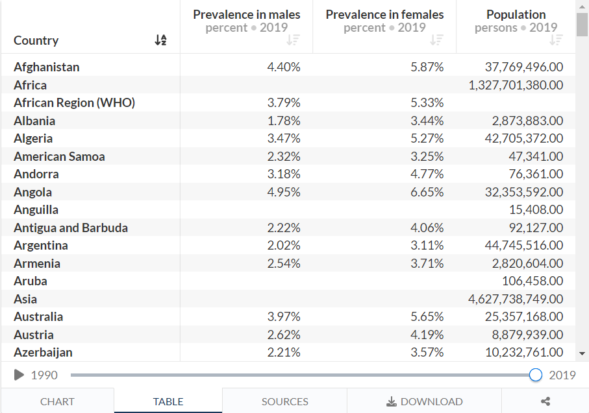
Prevalence of Depression by gender
From 1990 to 2019
Prevalence in males
Prevalence in females
Population
Rates are in percent (%)
Source: Depression

Slide 7
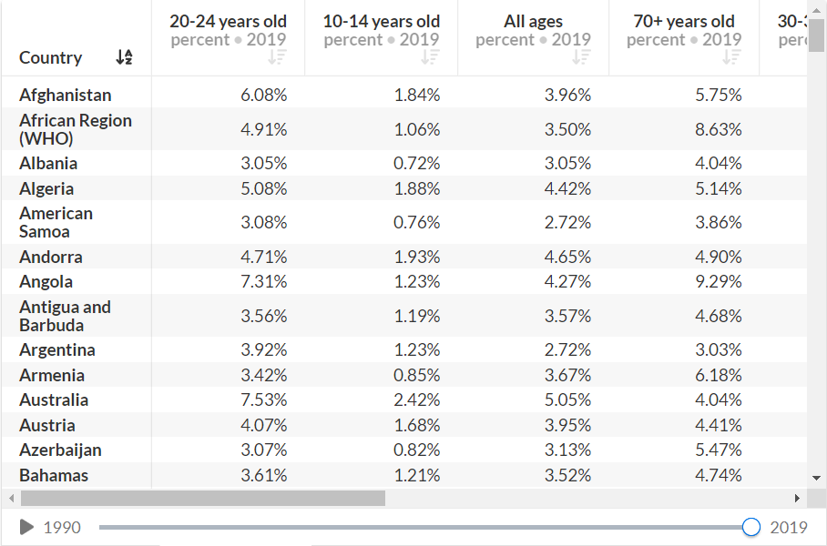
Prevalence of Depression by age
Several age groups’ depression rates from 1990 to 2019
Rates are in percent (%)
Source: Depression-Age

Slide 8
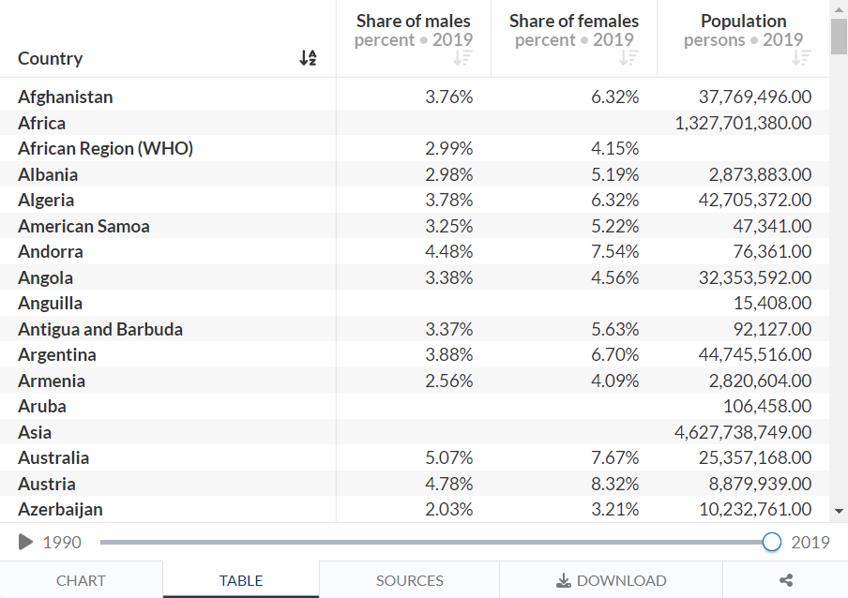
Prevalence of Anxiety by gender
From 1990 to 2019
Prevalence in males
Prevalence in females
Population
Rates are in percent (%)
Source: Anxiety

Slide 9

Prevalence of Schizophrenia by gender
From 1990 to 2019
Prevalence in males
Prevalence in females
Population
Rates are in percent (%)
Source: Schizophrenia

Slide 10

Prevalence of Bipolar Disorder by gender
From 1990 to 2019
Prevalence in males
Prevalence in females
Population
Rates are in percent (%)
Source: Bipolar Disorder

Slide 11
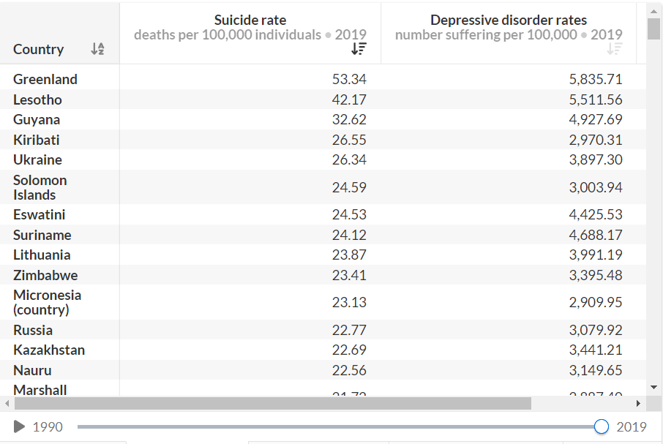
Suicide Rates vs. Prevalence of Depression
From 1990 to 2019
Suicide rates
Depression rates
Population
Rates are in per 100.000
Source: Suicide

Slide 12
EDA
Load Datasets
Clean the data
Drop columns that have mainly null values
Merge the datasets
Rename Columns
Arrange Column Order
Analyze Final Result

Slide 13
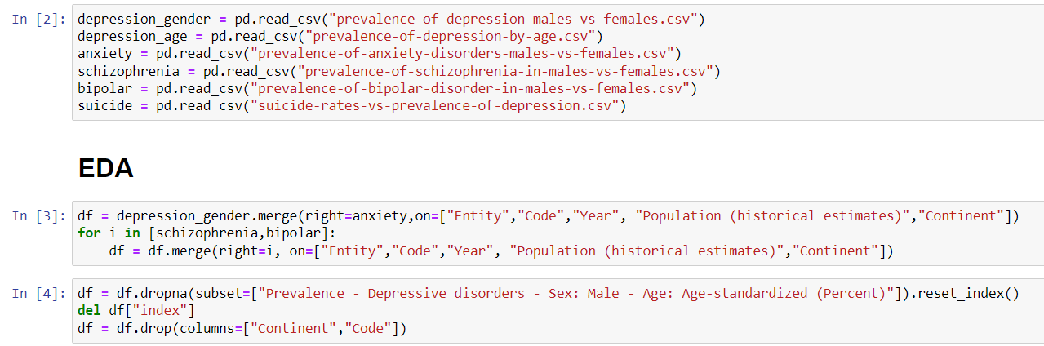
EDA
Loading Data
Merging Datasets
Dropping Cols with Mainly Null Values

Slide 14
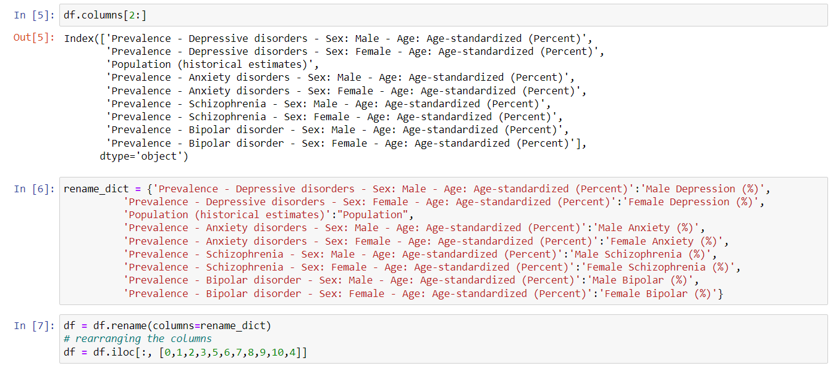
EDA
Renaming Columns
Arranging Column Order

Slide 15
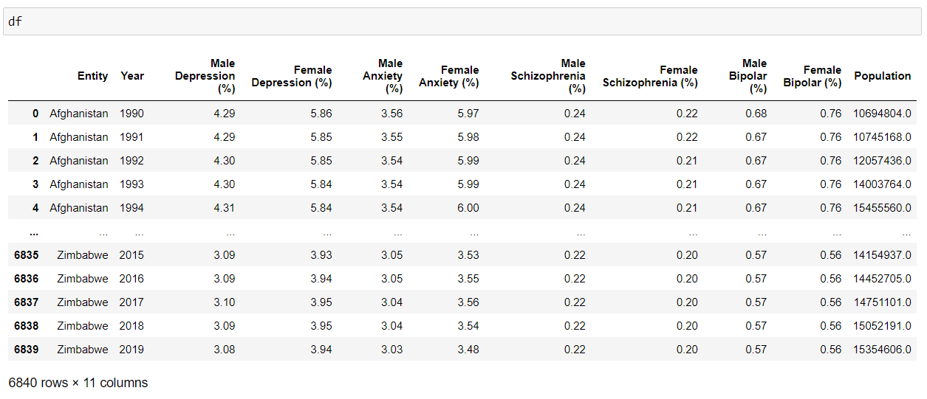
EDA - Final Dataset

Slide 16
Research Questions
What is the distribution of depression among the age groups?
Which countries have the most and the least depression rates?
Is there a correlation between depression and other mental disorders?
Is there a relation between countries’ development levels and depression rate? If there is, what is it?
Is there an increase in depression throughout the years?
Does an increase in rate of depression of a country cause an increase in the suicide rate of a country?
Are women more prone to be depressed than men or vice versa? (Hyphothesis Testing will be applied)

Slide 17
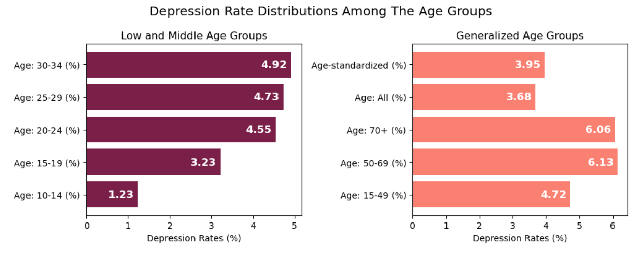
What is the distribution of depression among the age groups?
Middle and high age groups have greater depression rates.

Slide 18
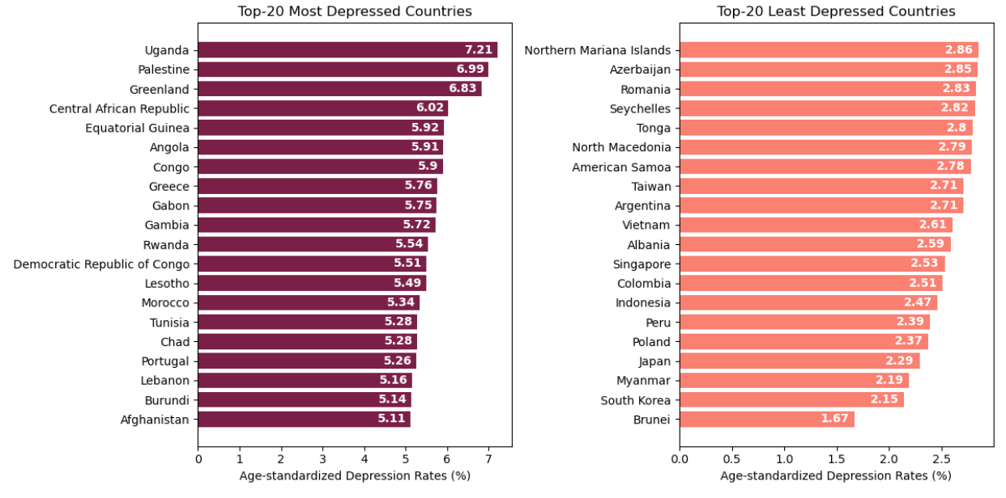
Which countries have the most and the least depression rates?

Slide 19
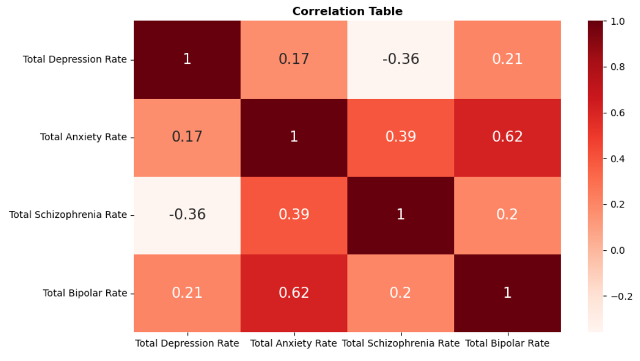
Is there a correlation between depression and other mental disorders?
Anxiety - Depression
Schizophrenia - Depression
Bipolar - Anxiety !

Slide 20
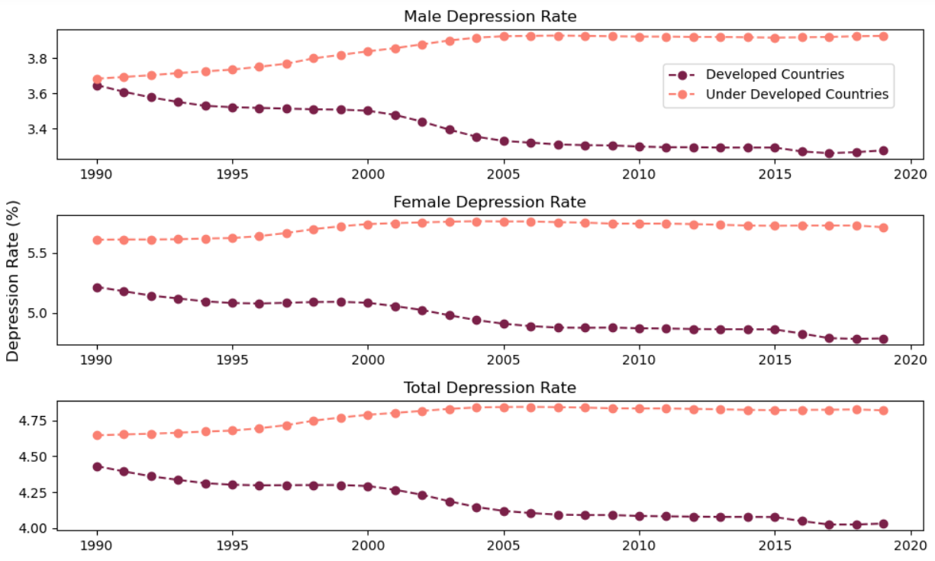
Is there a relation between countries’ development levels and depression rate?
Five samples from both developed and under developed countries
Country Development Source: World Economic Situation and Prospects 2022

Slide 21
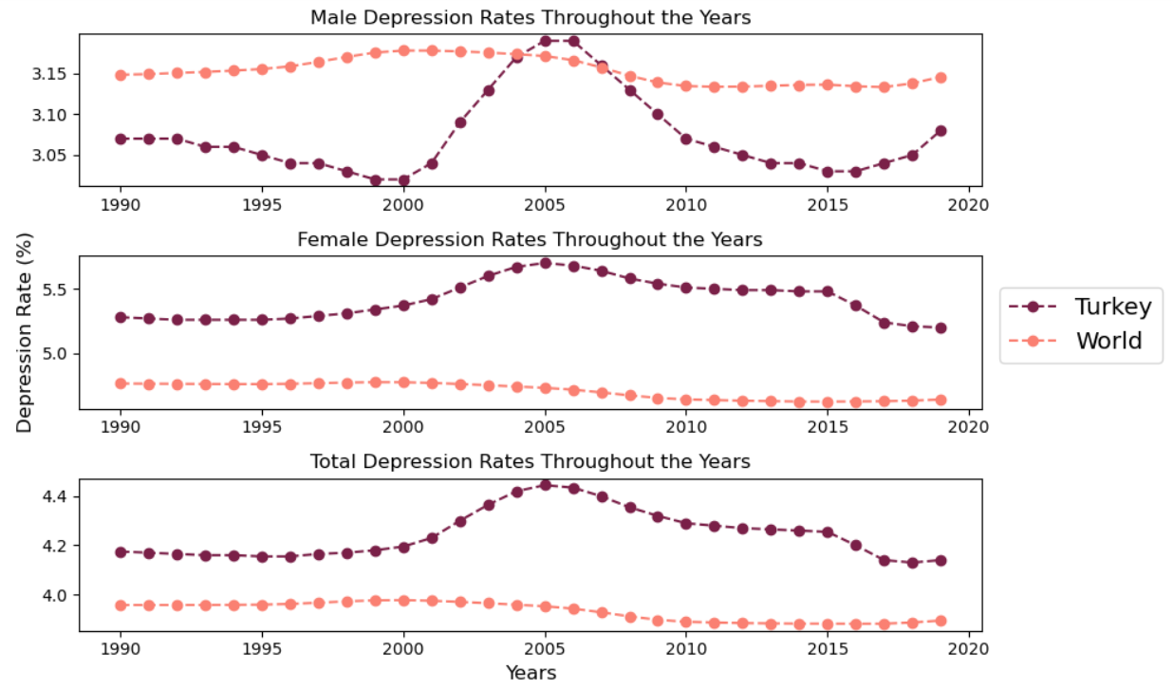
Is there an increase in depression throughout the years?
Looking from the perspective of Turkey and World

Slide 22
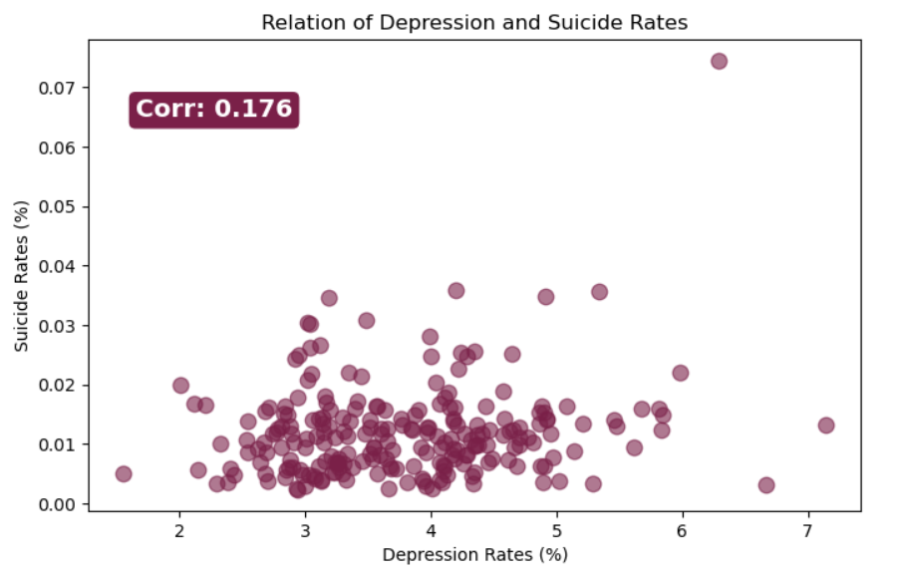
Does an increase in rate of depression of a country cause an increase in the suicide rate of a country?

Slide 23
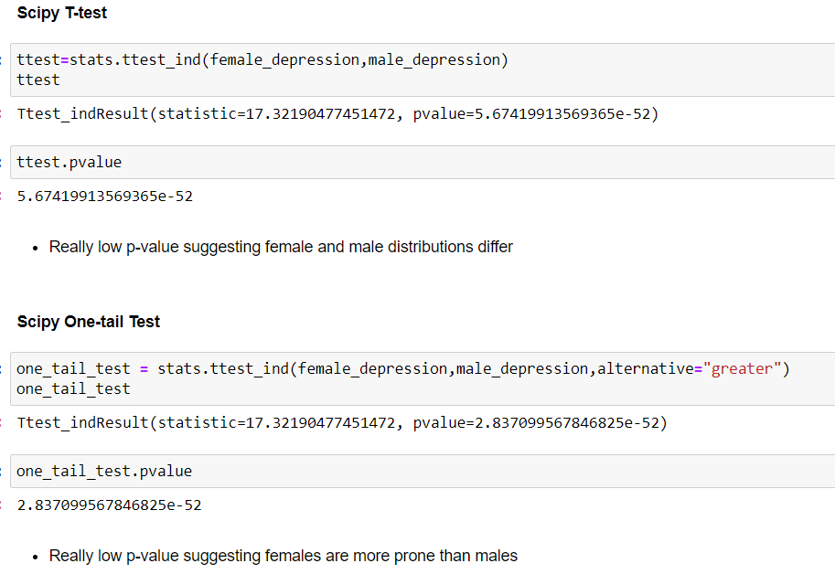
Are women more prone to be depressed than men or vice versa? (Hypothesis Testing)
Hypothesis tests yield the result that women are more prone to be depressed

Slide 24
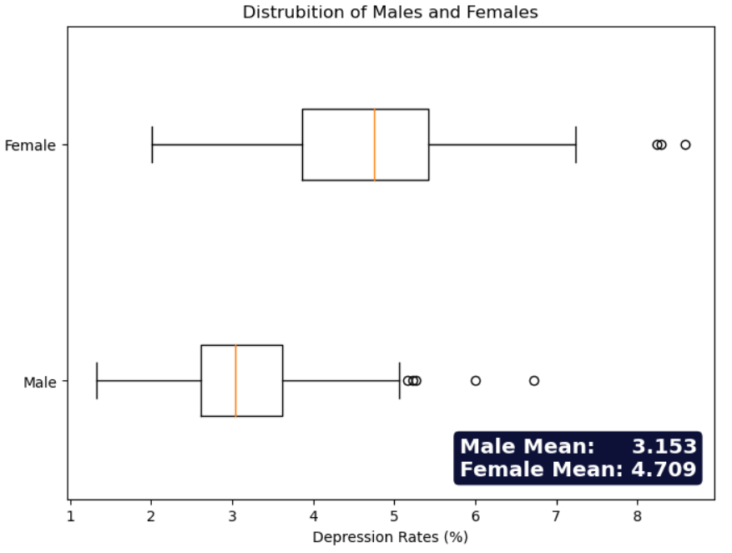
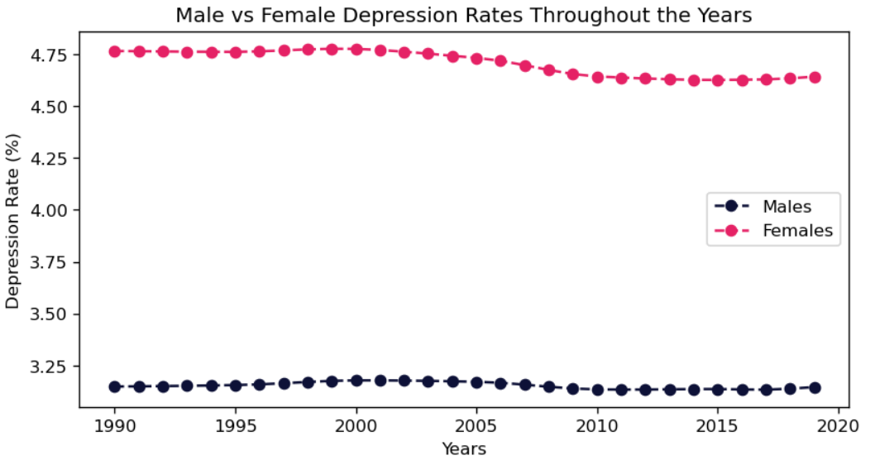
Are women more prone to be depressed than men or vice versa? (Hypothesis Testing)
Plotting the distribution of females and males for further understanding

Slide 25
Possible Further Research Questions
Is it possible to predict the future depression rates?
Is it possible to predict a country’s depression rate from other rates?
Is it possible to predict the development level of the country according to the depression rate ?

Slide 26
Is it possible to predict the future depression rates?
This is a supervised regression problem
By looking at the depression levels of earlier years, future years’ depression levels can be predicted
There is only one feature in this context which is the year. With each year’s depression levels the model will be trained.

Slide 27
Is it possible to predict a country’s depression rate from other rates?
This is another supervised regression problem
By looking at other mental disorder rates, a prediction of the depression rate can be made.
There are several features in this context. Anxiety, schizophrenia, bipolar disorder and suicide rates can be used. With these features and depression labels, model can be trained.

Slide 28
Is it possible to predict the development level of the country according to the depression rate ?
Clustering:
We can create a model that clusters the countries according to their mental disorder rates.
We need to consider the fact that we won’t be able to understand which cluster will be more developed
Classification:
If we can label the countries with their development levels as another feature, we can train a classification model to predict the development class of a given country.
We may use three clases: under developed, developing, and developed.

Slide 29
How to Convert This Project to a Service or Product
Governments
Medicine Companies
Commercial Companies
States to establish extra allowance for Community Mental Health.
How many drugs should pharmaceutical companies produce for which mental illness and production forecast for the coming years
Segments of society that commercial companies which marketing mental health drugs, should focus on as their target audience.

Slide 30
Issues Related to Data Engineering
Finding the data was quite challenging. Most of the data online weren’t big enough or sufficient.
After finding the data, deciding how to use it.
Finding different datasets and trying to format them in a correct way for merging
Integrating and processing the data for further data analysis.

Slide 31
Issues Related to Data Ethics
Getting permission from the people.
Sharing their information about their mental disorders.
Keeping privacy if needed.

Slide 32
Conclusion
Accomplishments of this project:
Analysis of depression and other mental disorders
Mental Disorders and its relation with the societies’ structure
Effects of mental disorders
Drawing attention to the importance of mental disorders

Slide 33
Thank you for listening

